Slide 1
MAX Model Automatic eXchange
AbdulMalik Shakir
President and Chief Informatics Scientist Hi3 Solutions | your healthcare standards conformance partner
October 2015
Notes:
10/5/2015
1

Slide 2
Overview
What is MAX?
The MAX Advantage
MAX EA and MS Excel Extensions
MAX_EA_Extension-1.15.0424.msi
MAXSchema_Excel.xsd
MAX XML Transform

Slide 3
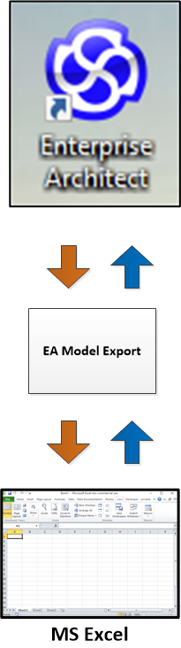
What is MAX?
MAX enables the exchange of UML model elements between Enterprise Architect and MS Excel.

Slide 4
The MAX Advantage
MAX is an alternative to the XMI and RTF export capabilities built into Enterprise Architect.
The MAX advantage is the ability to dynamically identify the subset of model elements and element properties exchanged.
MS Excel provides a user friendly means for SMEs to interact with the UML model developer.

Slide 5
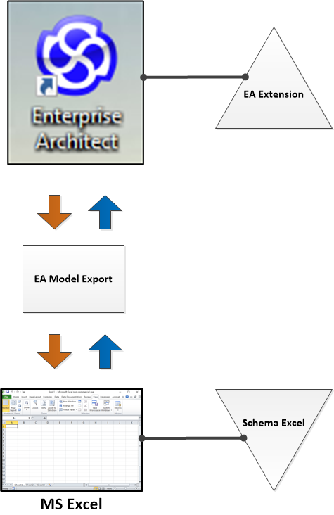
MAX EA and MS Excel Extensions
The two main components of MAX are:
EA Extension
Schema Excel

Slide 6
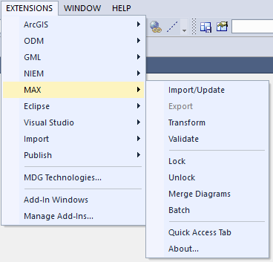
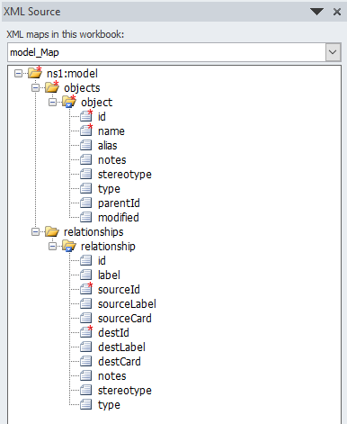
MAX EA and MS Excel Extensions
EA Extension
Schema Excel
MAX_EA_Extension-1.xx.yyyy.msi
MAXSchema_Excel.xsd

Slide 7
MAX_EA_Extension-1.15.0424.msi
Export
Creates an XML export of the model elements contained in the selected Package or Diagram.
Import/Update
Inserts or updates model elements contained in the selected Package or Diagram
Lock / Unlock
Disables or enable updates to the selected model elements

Slide 8
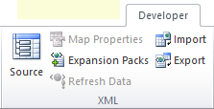
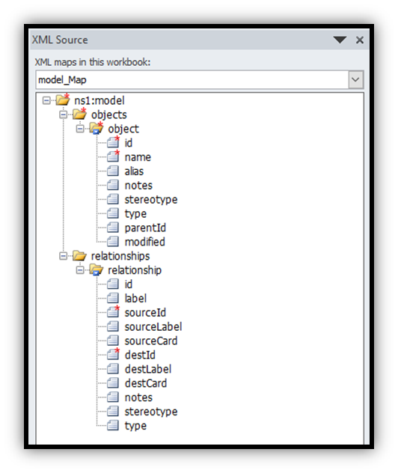
MAXSchema_Excel.xsd
Source
Used to set the MAXSchema Excel as the XML map
Import
Used to import content of from a MAX XML document
Export
Used to export content of the spreadsheet to a MAX XML document

Slide 9
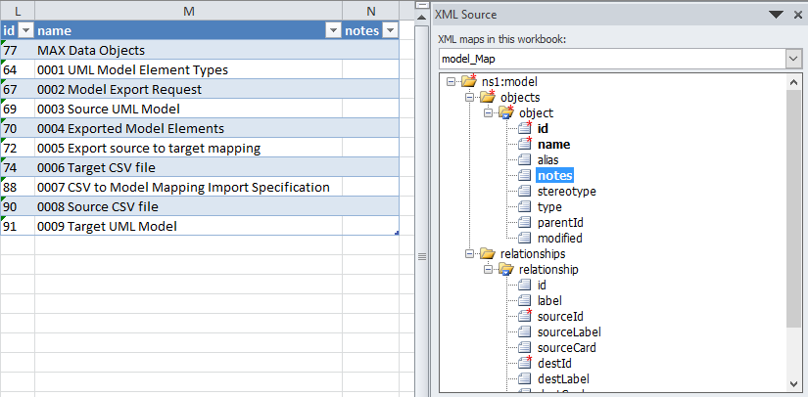
Model Elements in MS Excel
Drag and drop desired model element features to desired columns of the MS Excel spreadsheet.

Slide 10
MAX EA and MS Excel Extensions

Slide 11
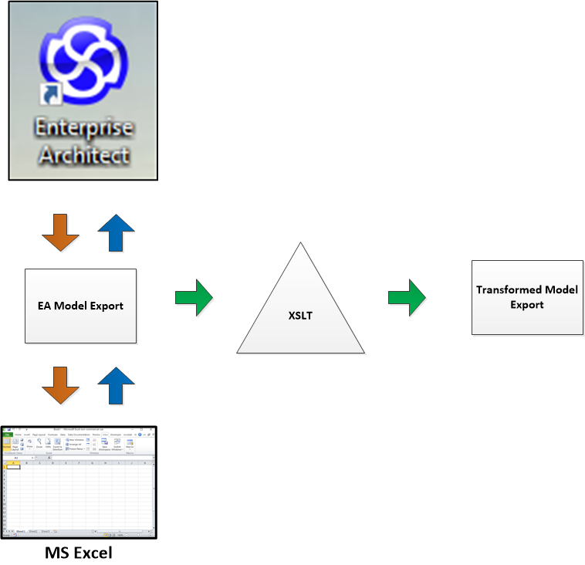
MAX XML Transform
XSLT can be used to transform the MAX XML export into other formats, such as HTML or PDF.

Slide 12
MAX

Slide 13
Thank You
Abdul-Malik Shakir President and Chief Informatics Scientist Hi3 Solutions 3500 West Olive Ave, Suite 300, Burbank, CA 91505
Skype: +1 9098334661  Mobile: (626) 644-4491 Email: abdulmalik.shakir@hi3Solutions.com

